Slide 1
Project2 final presentation: Linear mixed model with non-normal distribution of random components Speaker: Zhou,Wenru
Goal: investigate if the random effects distribution is NOT NORMALLY distributed, what would happen to
Estimation of fixed effects
The standard errors estimates of the fixed effects
The Type I/II error for the fixed effects hypothesis testing
Analyses:
2 kinds linear mixed models:
Random intercept model
Random intercept and slope model

Slide 2
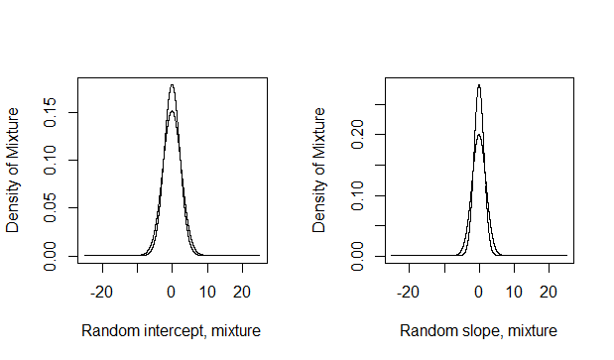
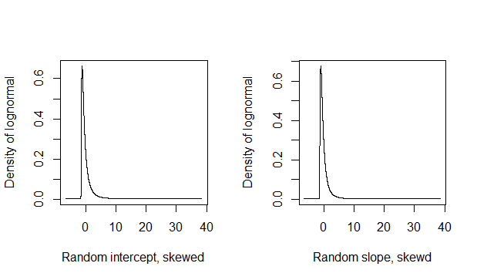
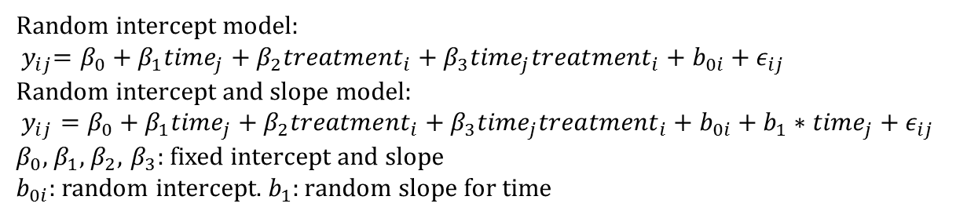
Mixed model and distribution of random effect
Random intercept model:
$${ y}_{ij}=β_{0}+β_{1}{time}_{j}+β_{2}{treatment}_{i}+β_{3}{time}_{j}{treatment}_{i}+b_{0i}+ε_{ij}$$
Random intercept and slope model:
$y_{ij}=β_{0}+β_{1}{time}_{j}+β_{2}{treatment}_{i}+β_{3}{time}_{j}{treatment}_{i}+b_{0i}+b_{1}∗{time}_{j}+ε_{ij}$
$β_{0}$, $β_{1}$, $β_{2}$, $β_{3}$: fixed intercept and slope
$b_{0i}$: random intercept. $b_{1}:random slope for time$

Slide 3
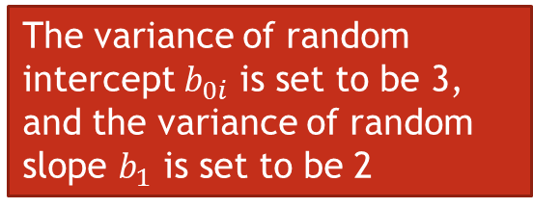
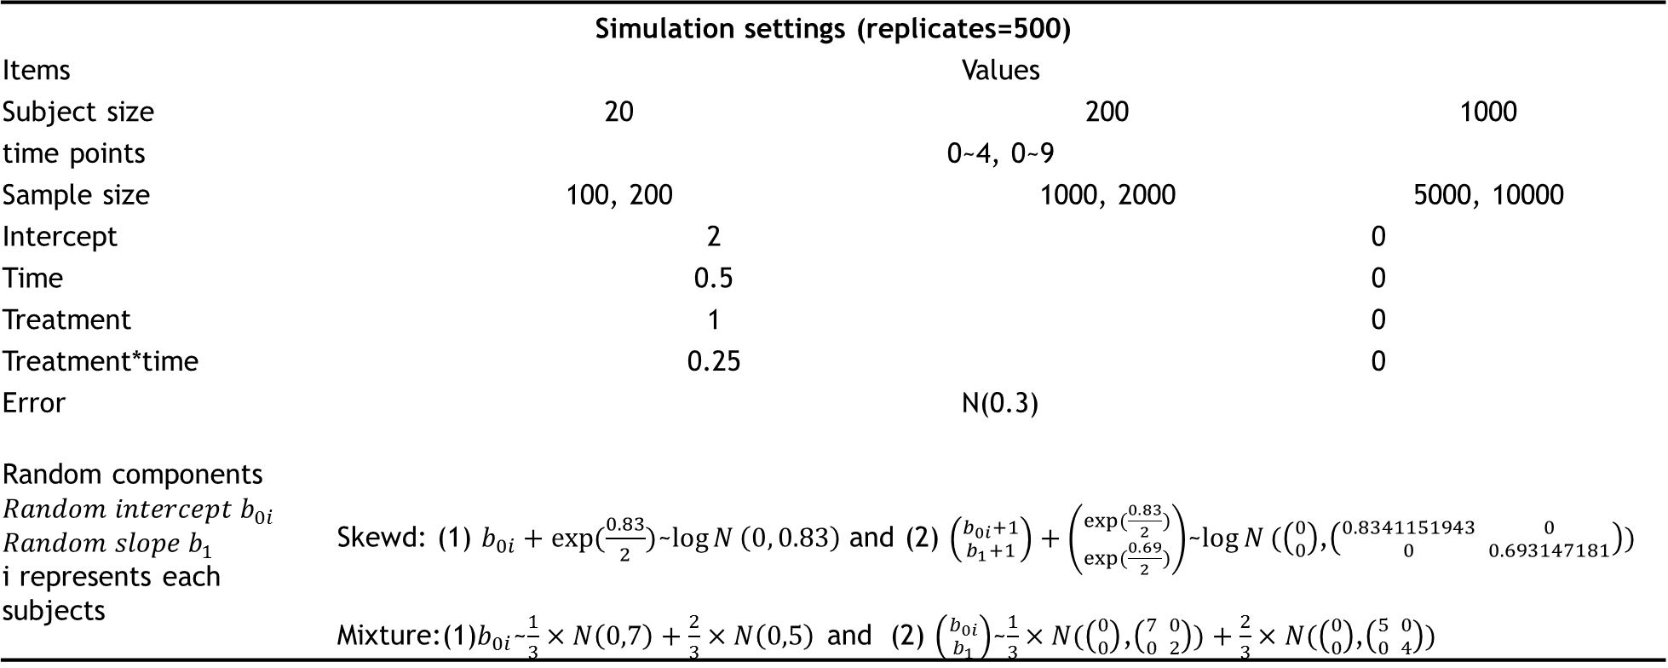
The case we would study
Simulation settings (replicates=500)
Items | Values
Subject size | 20 | 200 |  | 1000
time points | 0~4, 0~9
Sample size | 100, 200 | 1000, 2000 |  | 5000, 10000
Intercept | 2 |  | 0
Time | 0.5 |  | 0
Treatment | 1 |  | 0
Treatment*time | 0.25 |  | 0
Error | N(0.3)
Random components $$Random intercept b_{0i}$$ $$Random slope b_{1}$$ i represents each subjects | Skewd: (1) $b_{0i}+exp(\frac{0.83}{2})$~$\log{N}\left(0, 0.83\right)$and (2) $\left({b_{0i}+1 \atop b_{1}+1}\right)+\left({exp(\frac{0.83}{2}) \atop exp(\frac{0.69}{2})}\right)$~$\log{N}(\left({0 \atop 0}\right)$,$\left({0.8341151943 \atop 0} {0 \atop 0.693147181}\right))$ Mixture:(1)$b_{0i}$~$\frac{1}{3}×N\left(0,7\right)+\frac{2}{3}×N\left(0,5\right)$ and (2) $\left({b_{0i} \atop b_{1}}\right)$~$\frac{1}{3}×N(\left({0 \atop 0}\right)$,$\left({7 \atop 0} {0 \atop 2}\right))+\frac{2}{3}×N(\left({0 \atop 0}\right)$,$\left({5 \atop 0} {0 \atop 4}\right))$
The variance of random intercept $b_{0i}$ is set to be 3, and the variance of random slope $b_{1}$ is set to be 2

Slide 4
Simulation results
Random intercept with Skewed distribution
N=20, t=5
Decreased SE, bias
and type II error
N=20, t=10
 | Est | SD | SE | Bias | Type II error
Intercept | 2.022 | 0.687 | 0.031 | 0.022 | 0.098
Treatment | 0.961 | 0.972 | 0.043 | -0.039 | 0.786
Time | 0.487 | 0.168 | 0.008 | -0.013 | 0.198
Interaction | 0.274 | 0.236 | 0.011 | 0.024 | 0.780
 | Est | SD | SE | Bias | Type I error
Intercept | 0.008 | 0.656 | 0.029 | 0.008 | 0.058
Treatment | 0.004 | 0.921 | 0.041 | 0.004 | 0.060
Time | -0.001 | 0.060 | 0.003 | -0.001 | 0.046
Interaction | -0.002 | 0.085 | 0.004 | -0.002 | 0.048
Type I error is not affected
N=200, t=5
N=200, t=10
Intercept | 2.007 | 0.206 | 0.009 | 0.007 | 0
Treatment | 0.991 | 0.314 | 0.014 | -0.009 | 0.104
Time | 0.499 | 0.051 | 0.002 | -0.001 | 0
Interaction | 0.252 | 0.076 | 0.003 | 0.002 | 0.08
Intercept | 0.004 | 0.199 | 0.009 | 0.004 | 0.064
Treatment | 0.001 | 0.285 | 0.013 | 0.001 | 0.052
Time | -0.0001 | 0.020 | 0.001 | -0.0001 | 0.062
Interaction | -0.001 | 0.028 | 0.001 | -0.001 | 0.056
No difference of fixed effect estimation
was found between skewed distribution
and mixture distribution
N=1000, t=5
Intercept | 1.998 | 0.093 | 0.004 | -0.002 | 0
Treatment | 1.001 | 0.132 | 0.006 | 0.001 | 0
Time | 0.499 | 0.024 | 0.001 | -0.001 | 0
Interaction | 0.252 | 0.034 | 0.002 | 0.002 | 0
N=1000, t=10
Intercept | -0.004 | 0.086 | 0.004 | -0.004 | 0.046
Treatment | 0.004 | 0.120 | 0.005 | 0.004 | 0.032
Time | 0.0003 | 0.008 | 0.0004 | 0.0003 | 0.04
Interaction | -0.0001 | 0.012 | 0.001 | -0.0001 | 0.032
Random slope model
Subject=1000 | Coefficients ≠0(time=5), skew |  |  |  |  | Coefficients ≠0(time=10), mixture
Run=500 | Est | SD | SE | Bias | Type II error | Est | SD | SE | Bias | Type II error
Intercept | 1.997 | 0.096 | 0.004 | -0.003 | 0 | 1.993 | 0.080 | 0.004 | -0.007 | 0
 | 1.000 | 0.137 | 0.006 | 0.0003 | 0 | 1.003 | 0.115 | 0.005 | 0.003 | 0
Treatment | 0.502 | 0.065 | 0.003 | 0.002 | 0 | 0.496 | 0.062 | 0.003 | -0.004 | 0
Time | 0.250 | 0.092 | 0.004 | 0.000 | 0.242 | 0.255 | 0.084 | 0.004 | 0.005 | 0.154
Type II error of interaction in random intercept and time model is higher

Slide 5
Results and discussion
Conclusion: When the random effects are not normally distributed
As number of subjects increase, the SE, bias and type II error of coefficients of fixed effects decreases. We can choose a conservative p-value to control the type I error.
No difference of coefficients estimation was found between skewed distribution and mixture distribution
Discussion
Other types of outcomes, Binomial, Poisson, Gamma……
More variety on the number of subjects, then plot the coefficients and bias versus the number of subjects
Calculated the SE of bias to check consistency more accurately

